Slide 1
Accounting & Finance System
An accounting information system (AIS) is a structure that a business uses to collect, store, manage, process, retrieve and report its financial data so that it can be used by accountants, consultants, business analysts, managers, chief financial officers (CFOs), auditors and regulatory and tax agencies.
A financial management system is the methodology and software that an organization uses to oversee and govern its income, expenses, and assets with the objectives of maximizing profits and ensuring sustainability.

Slide 2
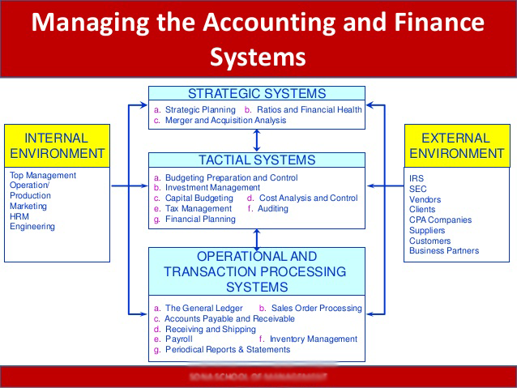

Slide 3
Marketing and Sales Systems
A system that analyzes and assesses marketing information, gathered continuously from sources inside and outside an organization.
A sales management system is a tool that helps salespeople get organized, manage their contacts better, track their sales deals more efficiently and save them time.
Distribution channel deals with providing the goods or services to the customers.

Slide 4
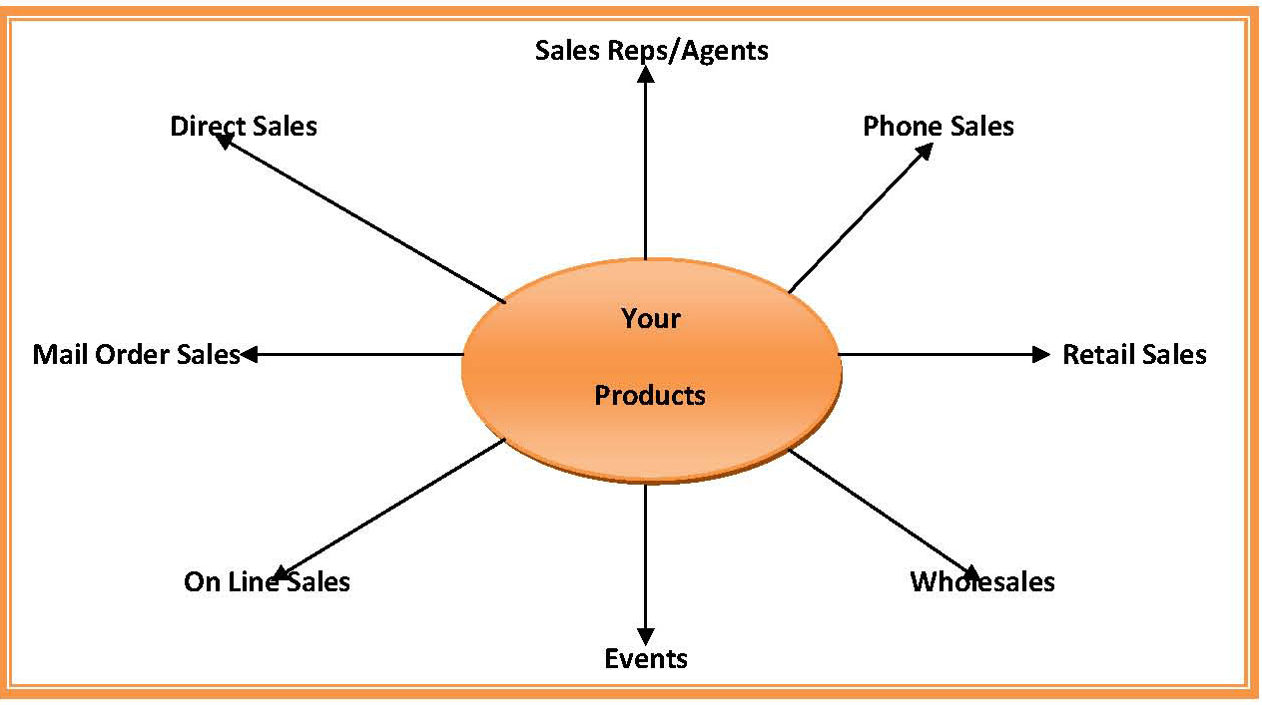

Slide 5
Channel Systems
Customer Service
Telemarketing
Distribution Channels Management
Marketing Management

Slide 6
Customer Service
Customer profile and preference analysis
Mass customization
Targeted advertising on the Web
Customer inquiry and automated help desk

Slide 7
Telemarketing
It is a process that uses telecommunications and information systems to execute marketing program
It can be done by regular phone calls or calls generated by computer programs.
It can be divided into 5 major activities: advertising, order processing, customer service, sales support and account management.

Slide 8
Distribution Channel Management
Delivery management
Improving sales at retail stores

Slide 9
Marketing Management
Pricing of products
Salesperson productivity
Product-customer profitability analysis
Sales analysis and trends
New products, services and market planning

Slide 10
Customer Relation Management
Customer relationship management (CRM) is a term that refers to practices, strategies and technologies that companies use to manage and analyze customer interactions and data throughout the customer lifecycle.
Its primary objective is to improve business relationships with customers, assisting in customer retention and driving sales growth.
CRM systems are designed to compile information on customers across different channels.
Also known as Relationship Marketing.

Slide 11
Production and Operations Management System (POM)
POM function is responsible for the processes that transform inputs into useful outputs.
It is responsible for Supply Chain Management (SCM)
POM includes 3 major activities:
Logistic and Material Management
Planning production and operation
Automated Design & Manufctures

Slide 12
Logistics and Materials Management
Logistics management is a supply chain management component that is used to meet customer demands through the planning, control and implementation of the effective movement and storage of related information, goods and services from origin to destination.
Material management is a scientific technique, concerned with Planning, Organizing &Control of flow of materials, from their initial purchase to destination.
* Inventory Management & Quality Control

Slide 13
Planning Production/Operations
Material Requirement Planning (MRP)
Manufacturing Resource Planning (MRP –II)
JIT
Project Management
Short Term Schedules

Slide 14
Automated Design Work & Manufacturing
CAD: Computer Aided Design
CAM: Computer Aided Manufacturing
CIM: Computer Integrated Manufacturing

Slide 15
Human Resource Management Systems
HRMS is a software application that combines many human resource functions such as benefits, administration, payroll, recruiting, training, performance analysis and review into one package.
Recruitment
HR Dev/Mt.
HR mgm/pl.

Slide 16
Recruitments
Position Inventory
Recruitment using Internet
Employee Selection

Slide 17
HR Maintenance and Development
Training
Performance Evaluation
Turnover, tardiness and absenteeism analyses

Slide 18
HR Management and Planning
Personnel files and skills inventory
Benefits administration
Government reports
Personnel Planning
Succession planning and implementation
Labor management negotiations

Slide 19
E- Commerce
E-commerce describes the buying, selling and exchange of products, services and information via computer networks.
Collaborative commerce (C-commerce)
B2C
C2B
C2C
Intrabusiness commerce
G2C
m-commerce

Slide 20
Benefits of E-commerce to Organizations
Expands company’s marketplace
Shortens or eliminates distribution channels
Decrease the cost of creating, processing, distributing and retrieving
Reduces inventory cost
Helps small business to compete against big companies
Enables specialized market

Slide 21
Benefits to Customers
Allows quick comparisons of products
Enables customers to shop or make transaction 24 hours a day
Delivers relevant and detailed information in seconds
Customize products
Electronic auction is possible

Slide 22
Benefits to Society
Enables us to work at home and do less travelling
People in rural areas can enjoy the products and services
Facilitates delivery of government or public services

Slide 23
Limitation of E-commerce (Technical)
Lack of universally accepted standards
Insufficient bandwidth
Ever evolving software tools
Difficult to integrate with existing applications and database
Need for special web servers
Expensive and inconvenient Internet connection

Slide 24
Non-Technical Limitations
Unresolved legal issues
Lack of mature methodologies to evaluate the benefits of e-commerce
Customer resistance to changing from a real to virtual store
Insufficient buyers and sellers

Slide 25
B2C Applications
Electronic storefronts
Electronic Malls
E-retailing or e-tailing

Slide 26
Issues in E-tailing
Channel Conflict
Order Fulfillment
Viability of e-tailers
Conflict between click-and-mortar organizations
Lack of funding
Incorrect revenue models

Slide 27
Service Industries Online
Cyberbanking
International and multiple currency banking

Slide 28
Collaborative Commerce
Retailer supplier
Vendor managed inventory
Product design
Collaborative manufcaturing

